Slide 1




How we are talking about data
Inputs
Assessment
Grading
Action

Slide 2

How we are using data

Slide 3




Where we might go
Investment Score
Program Score
New Score
Inputs
Assessment
Graded Output
Assessment
Action

Slide 4


Where I want to go
Investment Score
Program Score
New Score
Inputs
Assessment
Graded Output
Assessment
Action

Slide 5
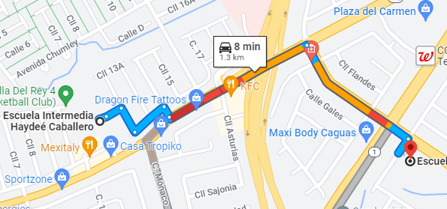
1.3 km ~ .8 miles

